Slide 1
NMGR P33A NEW MODEL JUSTIFICATION
Sun Roof assistant device modernization for P33A/B
Kadykov, Vladimir

Slide 2
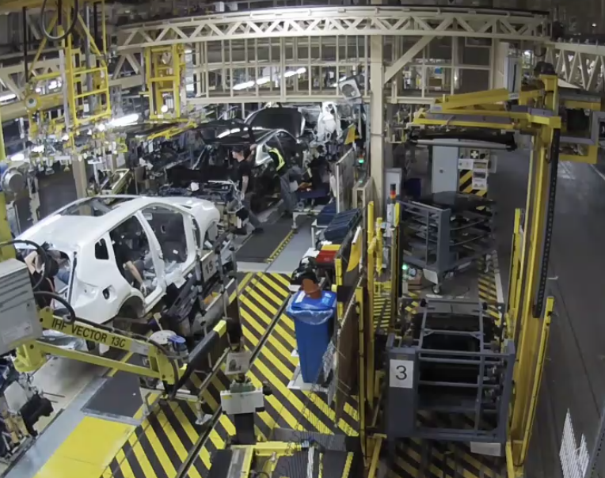
Project summary
Background
Due P33A/B changes, it is need to change the Sun Roof installation equipment.
Scope of work
Sun roof system modernization including:
positioning device, loader, lift, 4 dollies.
Project timing
Contract June`21
Manufacturing Nov`21
Installation Jan` 22
Sign-off Mar`23
Positioning device
Loader
Dollies
Lift
Budget
WBS-P-P33A2P/PT/PTC1/001
2227 KRub
M Rub
15,223 MRub
16,076 MRub
0,853MRub
Sun Roof modernization
budget
Saving
This PR
amount

Slide 3
Thank you

